Slide 1
Thermo
Computer Assistant
||||||||||||||||||||||||||||||||||||||||||||||||||||||||||||||||||||||||||||

Slide 2

Mini Project
on
Computer Assistant which work Offline and Online
Both the Modes
BY
MANAS BARNAWAL
1901320310047
Under the guidance
of
Mr. Sunil Kumar Yadav

Slide 3
OBJECTIVE

Slide 4
Computer Assistant
Computer Assistant are use to assist Computer users with technical issues through problem-solving.
It helps Computer users in better interface for working on the computer.
It also reduce the work efforts of the user on the computer .
Some examples of Computer Assistant now a days are :-
Cortana (Windows assistant)
Siri (IOS assistant)

Slide 5
METHADOLOGY

Slide 6
About THERMO and its UNIQUENESS
As I describe Computer Assistant before , it is to assist user in technical work.
As for my knowledge all the popular computer assistant available in the market do use internet to perform even their single task.
So I am developing a assistant which can perform task (which do not require internet) offline.
Thermo can automatically check wheater your device is connected through internet or not.
This make THERMO a unique assistant.
Although it can not work as a proper assistant but I am working on it to add as many features as I can to make THERMO a good assistant.

Slide 7
DESIGN and RESULT

Slide 8
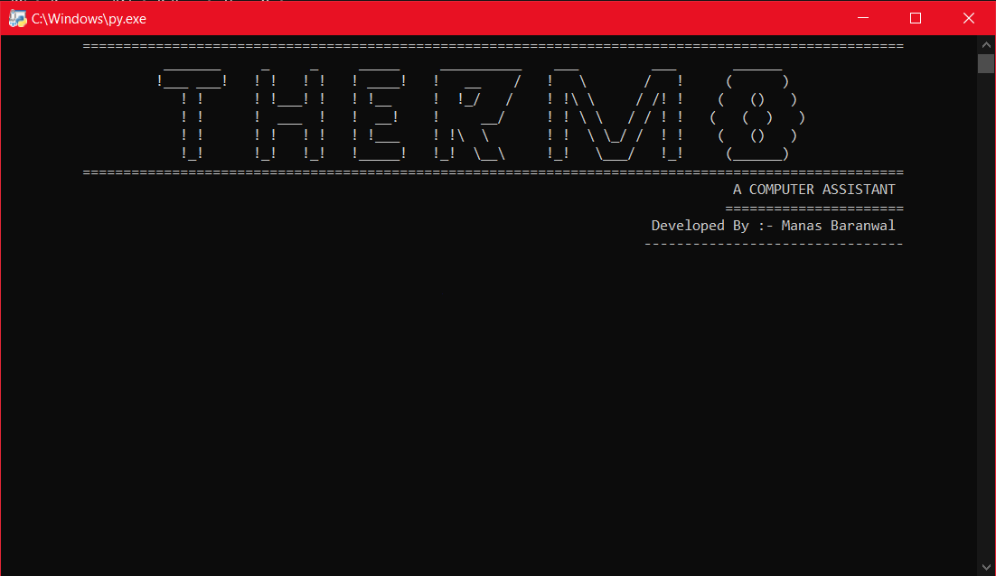
First Look

Slide 9
Language Used
PYTHON
Python is an interpreted, object- orientated and a high level programming language.
It is a general purpose programming language that is often applied in scripting role.
Why I use python for creating my project :-
Easy to understand & Easy to learn.
Simple to use.
Rich libraries.
Fewer code lines , less time.
It has a big community.

Slide 10
Python libraries used
Pyttsx3
Text to speech library.
Speech Recognition
Speech to text library.
OS
Provide interface to program
with the operating system.
Pocket Sphinx
Help Speech recognition module
to recognize voice offline.
Wolframalpha
It is an api module which
Compute expert-level answers.
Wikipedia
Wikipedia module.
Webbrowser
It provide interface to search
anything using default browser
Datetime, time, google search ,
Etc. as for the requirement.

Slide 11
What can this Assistant do for you?
Thermo can work as both Online and Offline mode .
While on Online mode :-
It can open Websites.
It can open applications (like MS Word ,VS Code ,Spotify etc) .
It can search on Wikipedia.
It can save reminders .
It can provide as current time.

Slide 12
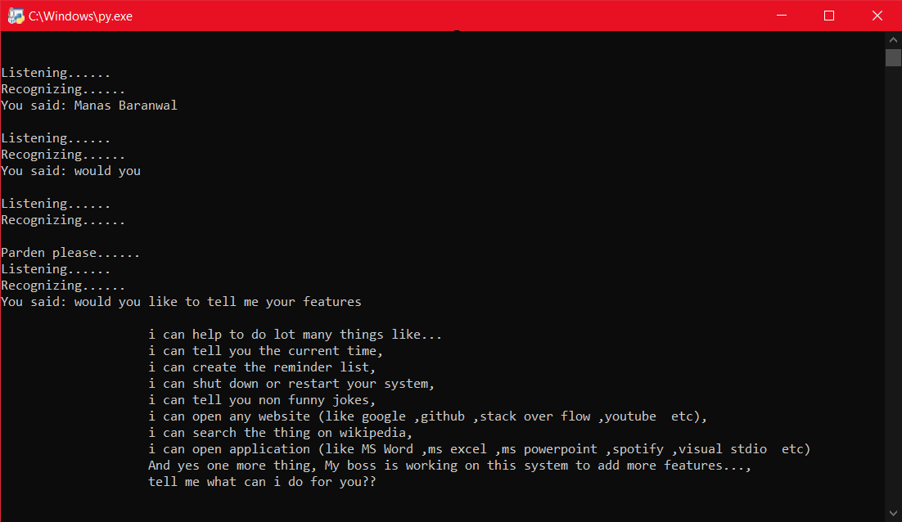
Online Mode

Slide 13
While on Offline mode :-
To recognize the voice offline I used a module which is Pocket Sphinx.
But the issue is that it is less accurate in recognizing the Indian English.
Tasks like
It can open applications (like MS Word ,VS Code ,Spotify etc) .
It can save reminders .
It can shutdown and restart your computer.
It can provide you current time and date.

Slide 14
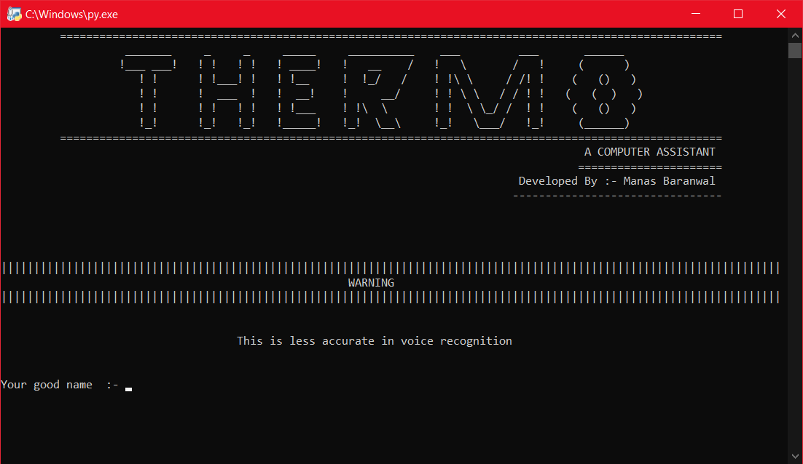
Offline Mode

Slide 15
CONCLUSION

Slide 16
Is THERMO an A.I.?
A lot of people will argue that the virtual assistant that I have created is not an A.I. , but it is the output of the bunch of the statements. But , if we look at the very basic level , the sole purpose of an A.I. Is to develop machines that can perform human tasks with the same effectiveness or even more effectively than humans.
It is a fact that this virtual assistant is not a very good example of A.I. , but it is an A.I.

Slide 17
Advantages of THERMO
This work on the voice commands.
It will neglect the time taken by the user to open a application (which he/she use frequently).
You can even use this assistant without internet.
Somehow this provides a different interface between the User and his/her Personal Computer.
User can search the web , wikipedia.

Slide 18
Disadvantages
For now this will only work on Windows Operating System.
When in offline mode it is less accurate in listening the voice.
If more than one commands are given at the same time it will only perform the command whose source code is written at first.
It is not a very good A.I. .

Slide 19
FUTURE SCOPE

Slide 20
Currently, there are several different companies developing virtual assistant technology, each targeting their own devices and hardware. For example, Microsoft’s Cortana works best with Windows 10 devices, Amazon’s Alexa works best with Amazon Devices, and Google Home uses its own platform.
More over in future these are going to be a part of our daily life.
So, the future scope of my virtual assistant “THERMO” will be bright by the requirement it fulfil for the user who will be using it.
It has to be more user friendly and perform more task in future. And I would love to make this assistant capable to run in all the Internet of Things (IoT) devices in future.

Slide 21
References
While working on THERMO I had a big help from “ Youtube “ for where to start with.
“ Internshala “ was the platform from where I had learn python language and had a good command on it.
As I said before python has a big community , so I even have many help from them by websites “ Github , Stackoverflow etc “ .

Slide 22


